Slide 1
Coronary Artery Disease
Team 9
Isabel Pham
Nahal Bagheri

Slide 2
Introduction

Slide 3
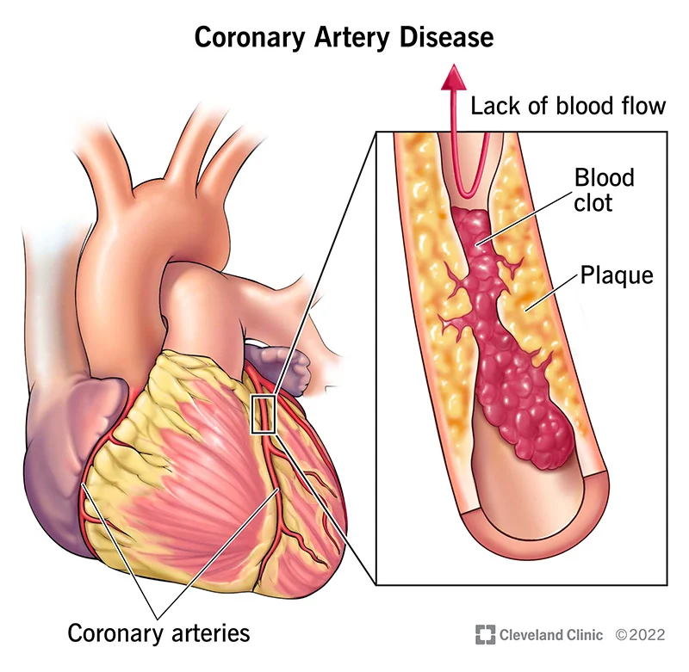
What is Coronary Artery Disease (CAD)?
A heart disease where our arteries fail to bring in sufficient oxygen-rich blood to our heart

Slide 4
Motivation
Issues
One of the leading cause of death in U.S.
No absolute cure
CAD is a progressive disease
Will worsen over time
Why?

Slide 5
Objective
Make a machine-learning model that will predict whether someone has coronary artery disease (CAD)
Detect CAD disease and apply treatment as soon as possible

Slide 6
Approach
Obtain a good source of data
Preprocess the data
Exploratory Data Analysis
Feature Engineering:
Feature Scaling
Feature Selection
Handling Missing Values
Discretization
Domain-Specific Features
Machine-Learning Models
Evaluation

Slide 7
Dataset

Slide 8
Hospital Data Admission
Comprehensive collection of patient data spanning 2 years at Hero DMC Heart Institute in Ludhiana, India
Includes data like age, gender, hypertension, etc.
Dataset from Kaggle

Slide 9
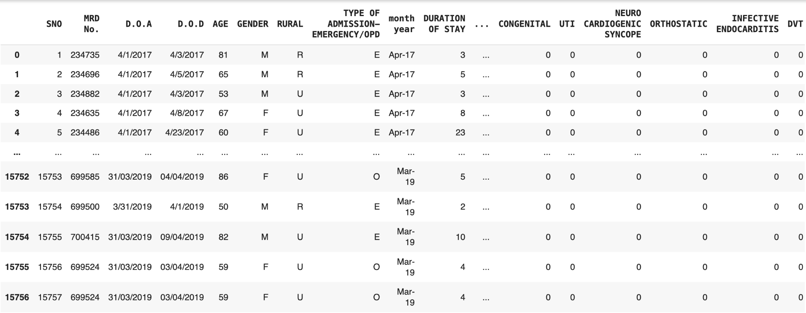
Observing the Raw Dataset
15,575 rows and 56 columns

Slide 10
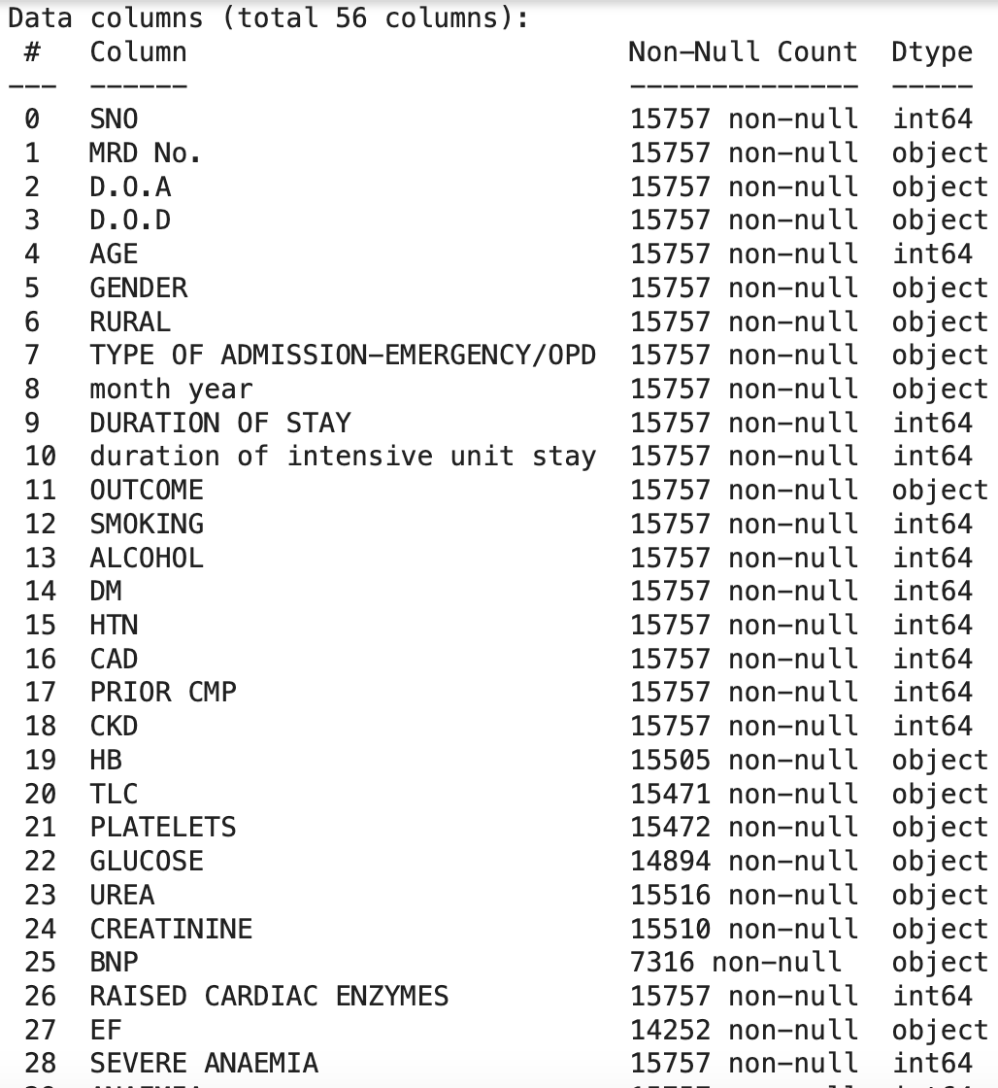
Observing the Raw Dataset
A mix of categorical and numerical features
Hospital Administrative data are included and needs to be removed
Some of the feature types are set to “object” despite data being mostly numerical
Candidate for clean up

Slide 11
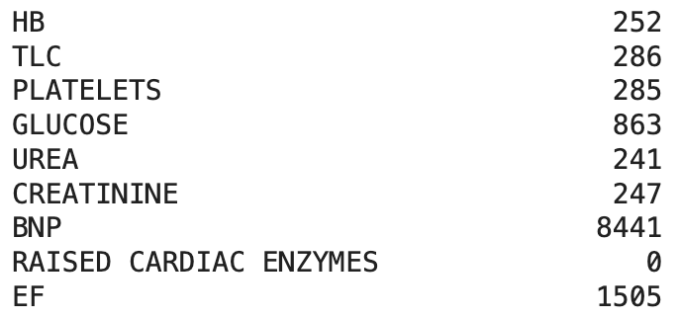
Observing the Raw Dataset
Missing values for some features
Notes:
We remove those that are missing because we really can’t assume that their levels for those features are neutral.

Slide 12
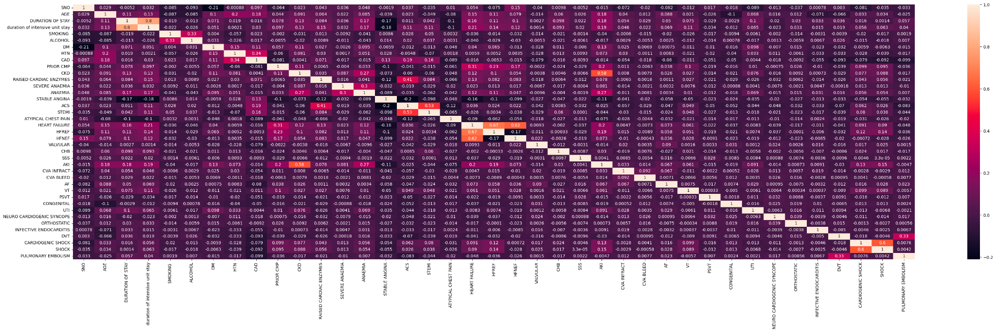
Observing the Raw Dataset: Heat map

Slide 13
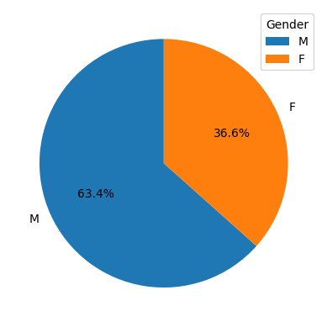
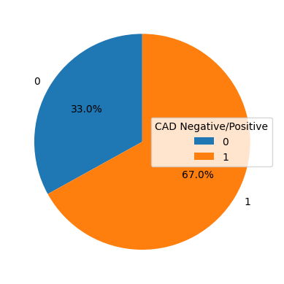
Observing the Raw Dataset: Pie Charts

Slide 14
Overall Observations of the Raw Dataset
Data is slightly imbalanced
10551 patients has CAD whereas only 5206 patients does not
Missing values for some features
Incorrect type for some features (some are objects when it should be float)

Slide 15
Preprocessing Steps
Remove features that do not associate with a patient’s wellbeing (Ex: administrative data)
Remove rows with missing or invalid data
Use OneHotEncoder on categorical features

Slide 16
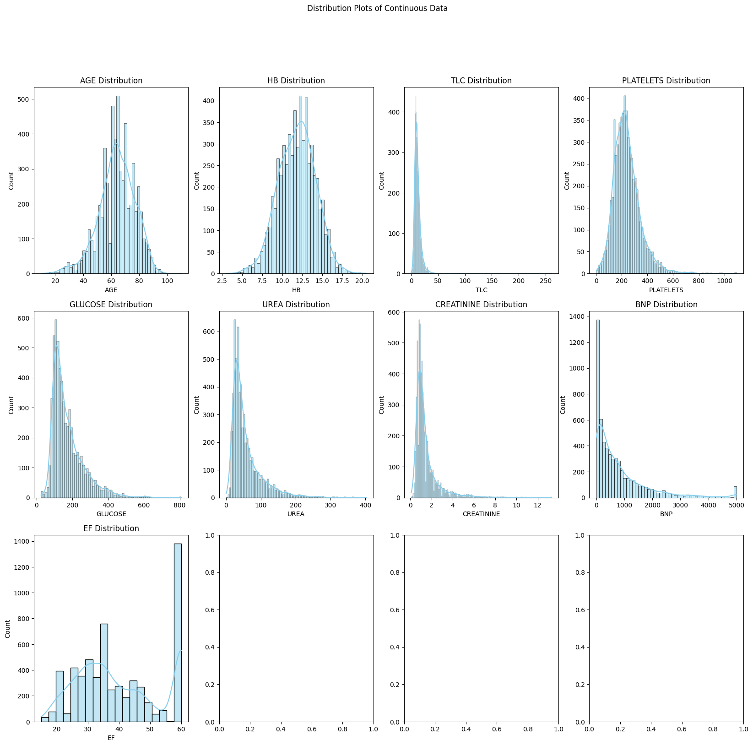
After Preprocessing
Can now see distribution of continuous and numerical features

Slide 17
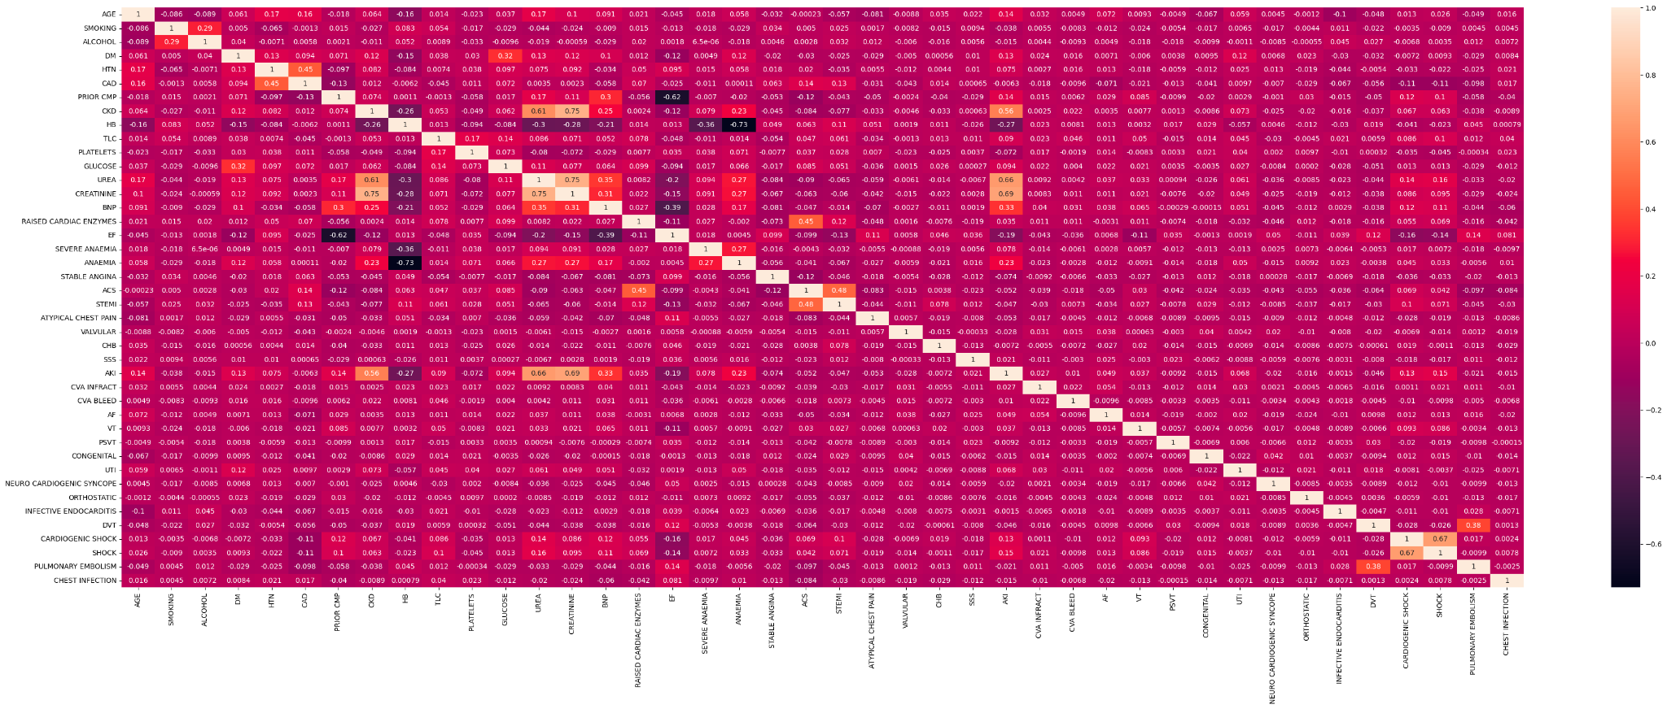
After Preprocessing: Heat map Visualization

Slide 18
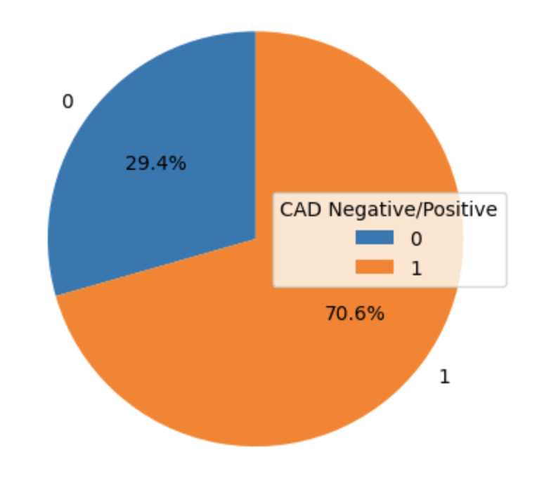
Balancing the Dataset
After preprocessed: 5897 rows
Data is still imbalance
80% train, 20% test
Made two versions:
Undersample train → 2778 rows
Oversample train→ 6656 rows
Then applied normalization

Slide 19

Modeling
Random Forest
Naive Bayes
Support Vector Machines
Decision Tree
Logistic Regression
K-nearest neighbors

Slide 20
Model Hyperparameters
Random Forest | n_estimators | max_depth | min_samples_split | min_samples_leaf | max_features
Undersample | 100 | None | 2 | 1 | sqrt
Oversample | 100 | None | 2 | 1 | sqrt
SVM | C | Kernel | Gamma
Undersample | 0.1 | linear | 0.1
Oversample | 0.1 | linear | 0.1

Slide 21
Model Hyperparameters (cont.)
Naive Bayes | Var_smoothingfloat
Undersample | 1e-9
Oversample | 1e-9
Decision Trees | max_depth | min_sample_split | min_sample_leaf | max_feature
Undersample | 10 | 10 | 2 | None
Oversample | 20 | 2 | 1 | None

Slide 22
Model Hyperparameters (cont.)
Logistic Regression | C | splver | Penalty
Undersample | 100 | liblinear | l1
Oversample | 100 | liblinear | l1
K-nearest neighbors | n_neighbors | weights | metric
Undersample | 15 | distance | Manhattan
Oversample | 9 | distance | Manhattan

Slide 23
Results and Evaluation

Slide 24
Evaluation Metrics
Will look at accuracy, precision, recall, and f1-score.
Prefer Recall or True Positive Rate (TPR)
Avoid False Negative Rate (FNR)
True Positive = patient has CAD, test says positive
False Negative = patient has CAD, test says negative

Slide 25
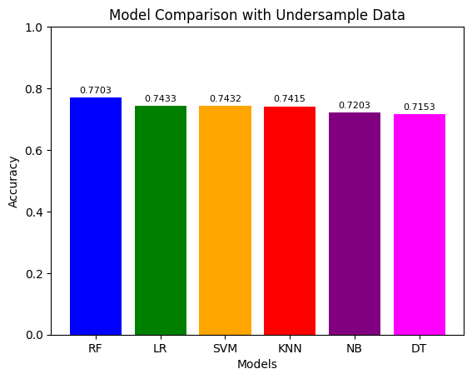
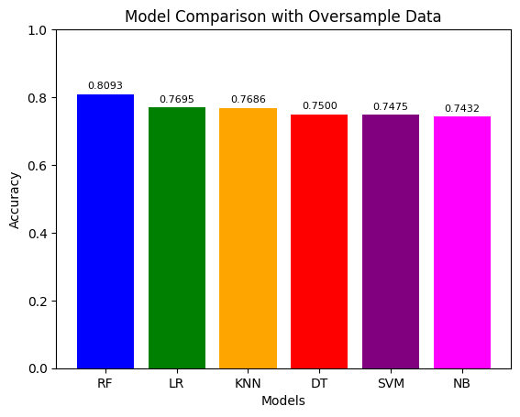
Result

Slide 26
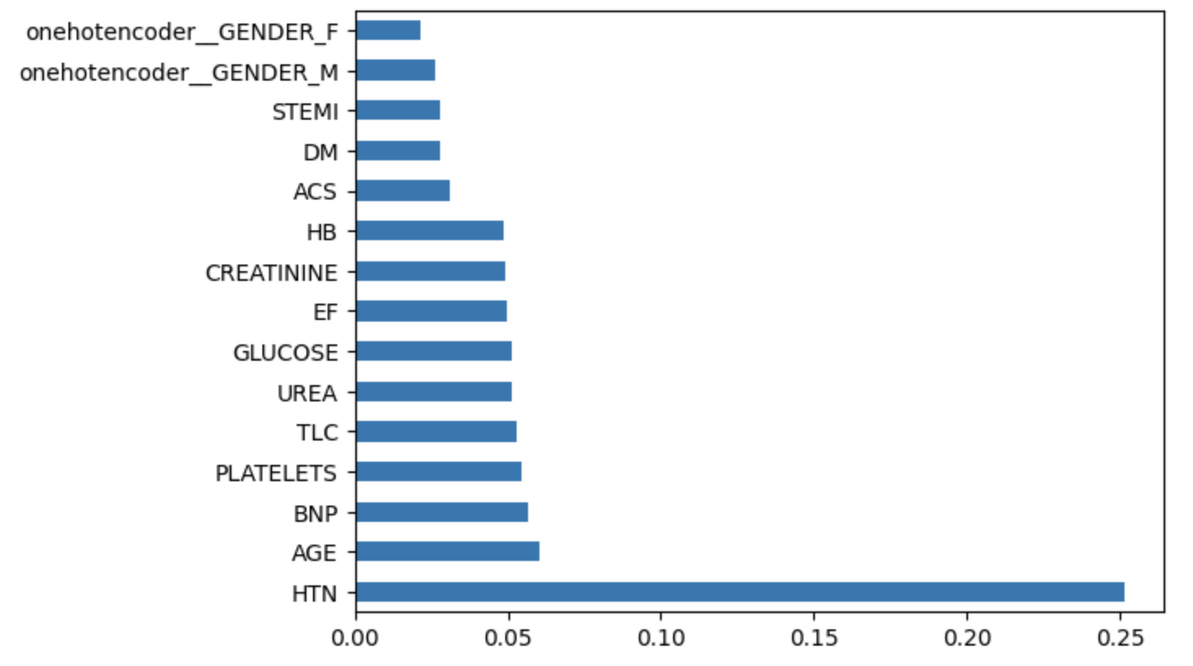
Random Forest Top 15 feature importances (Oversample)

Slide 27
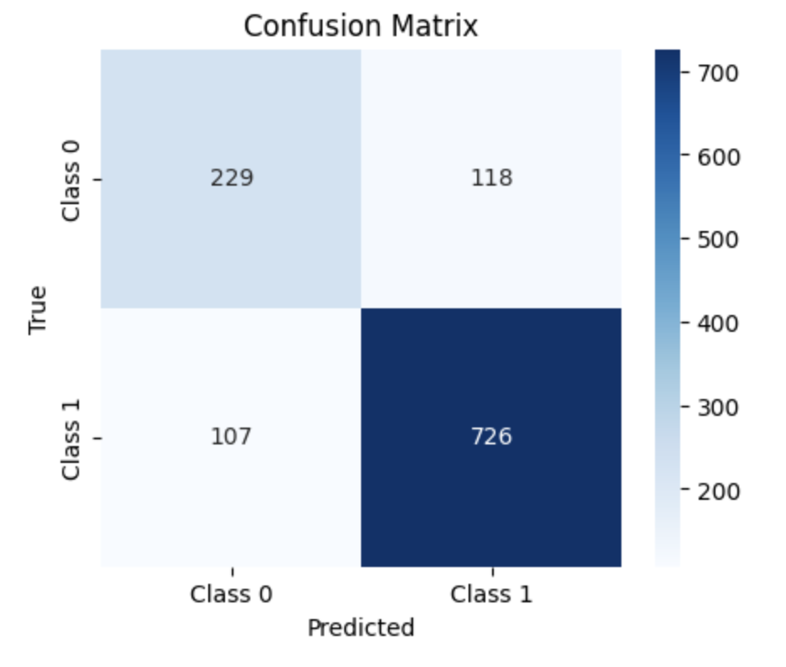
Random Forest Confusion Matrix (Oversample)

Slide 28
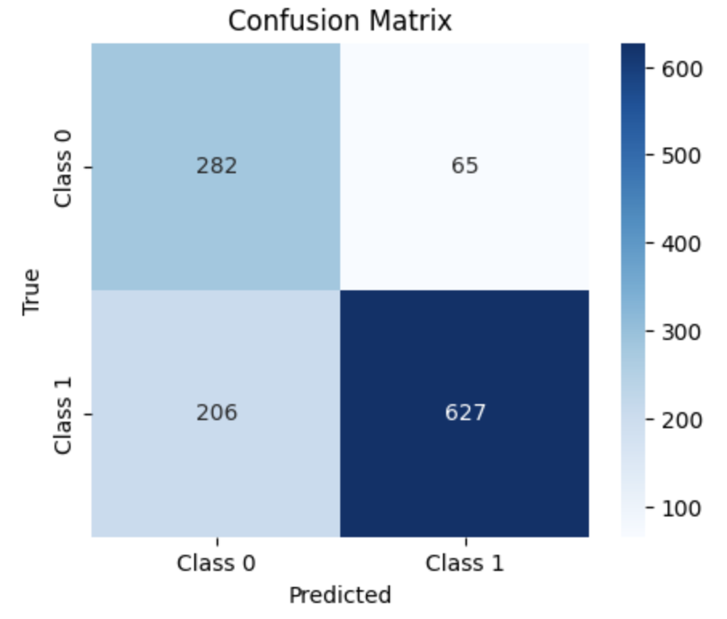
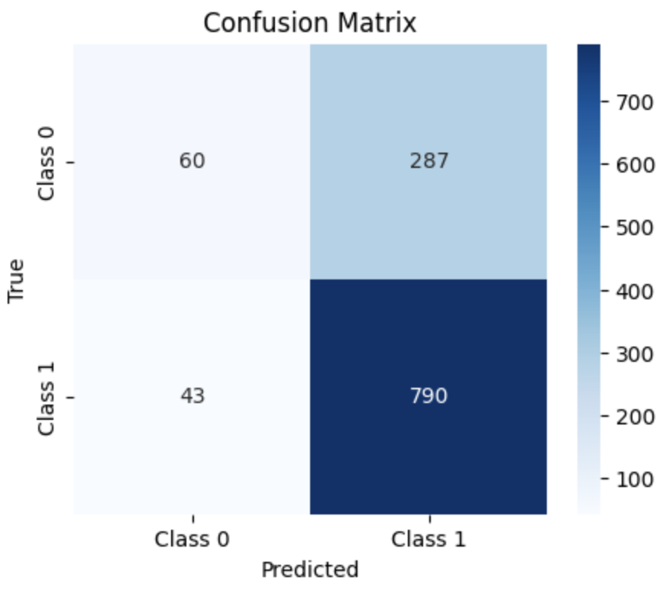
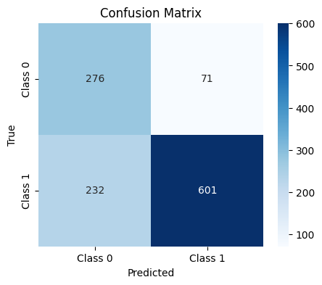
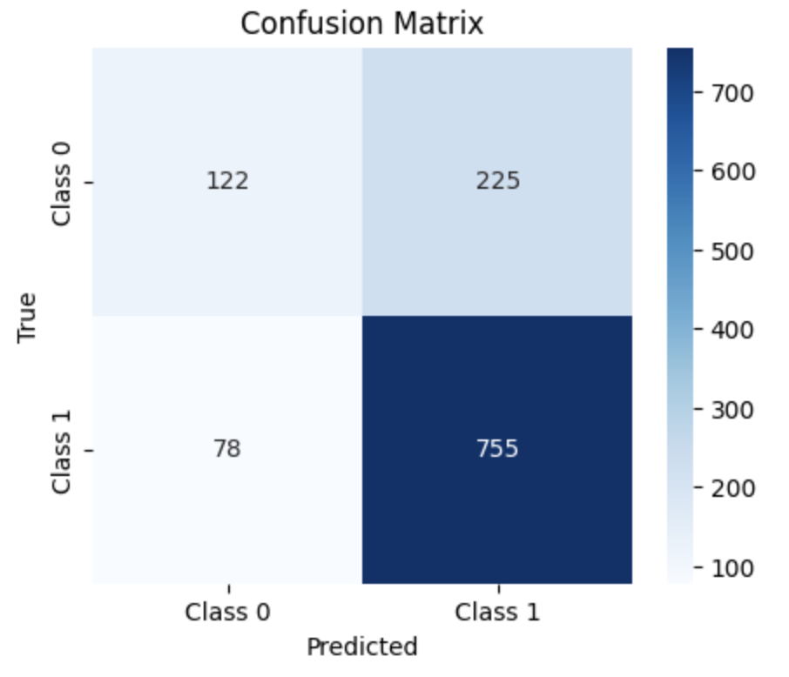
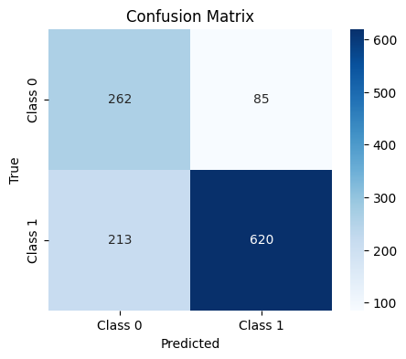
Random Forest, Naive Bayes, SVM
Random Forest | Naive Bayes | SVM
Undersample
Oversample

Slide 29
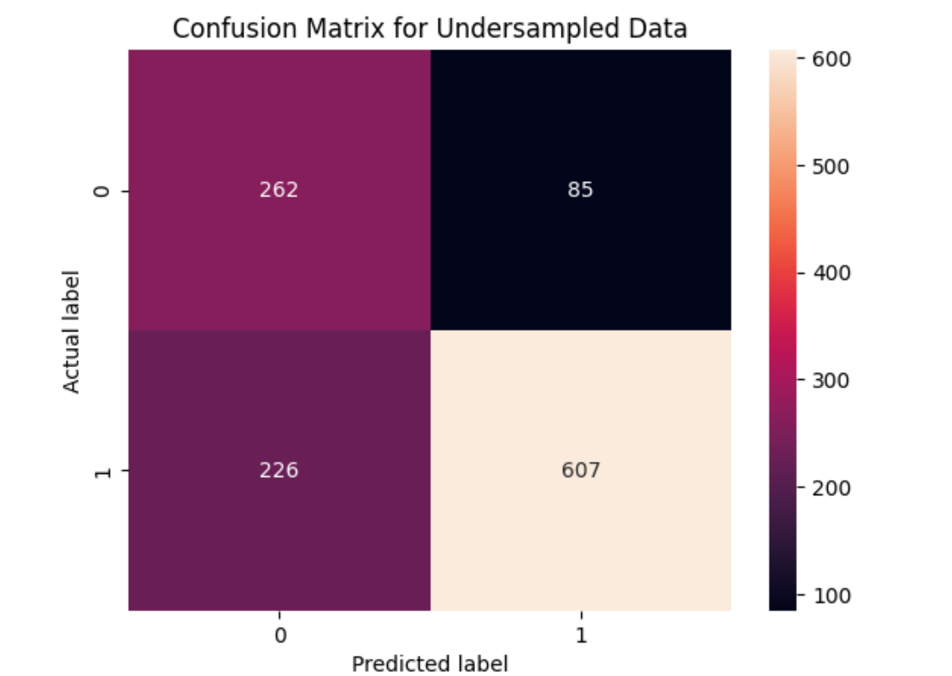
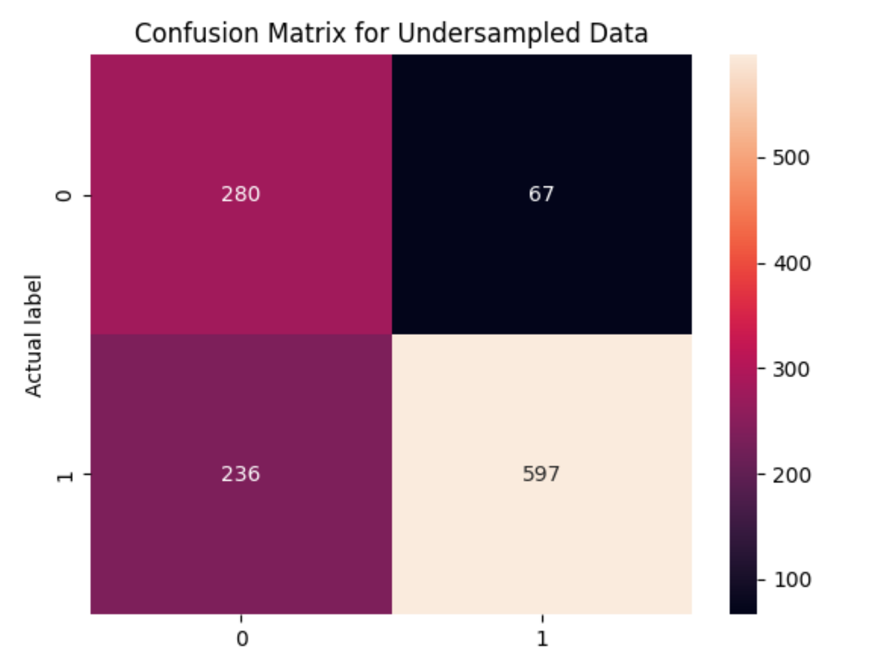
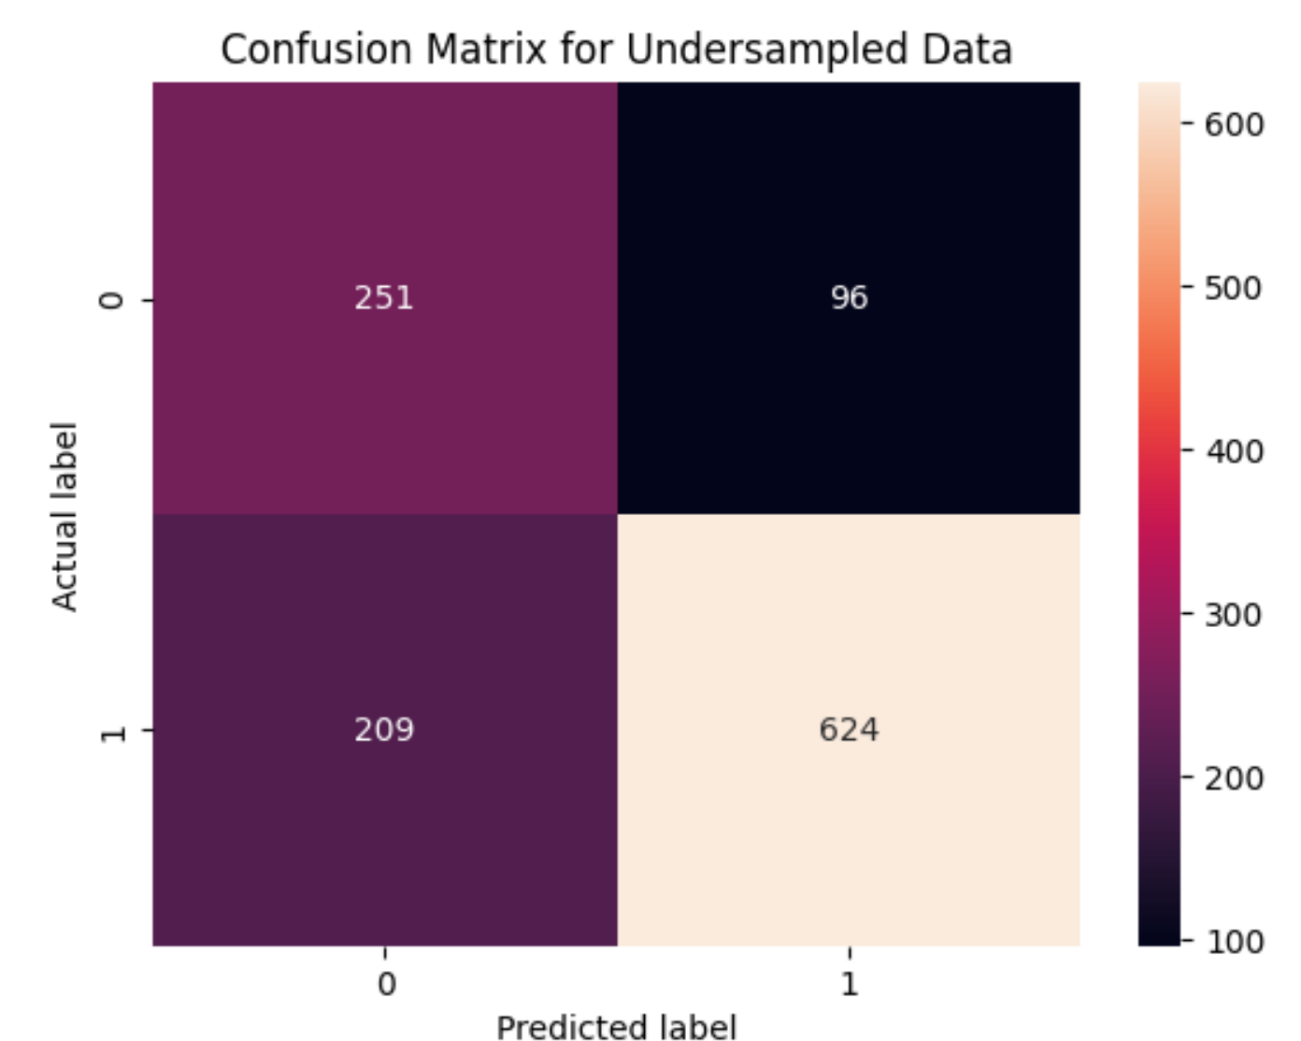
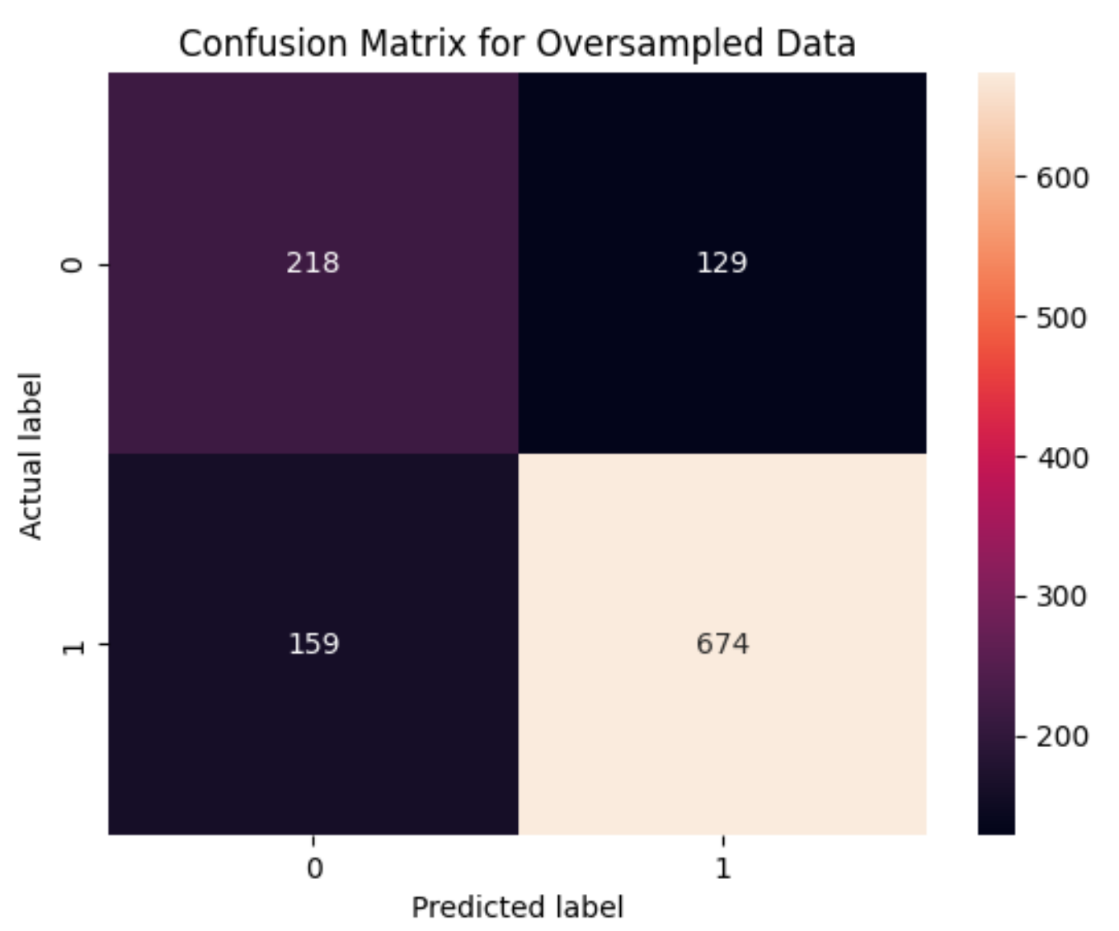
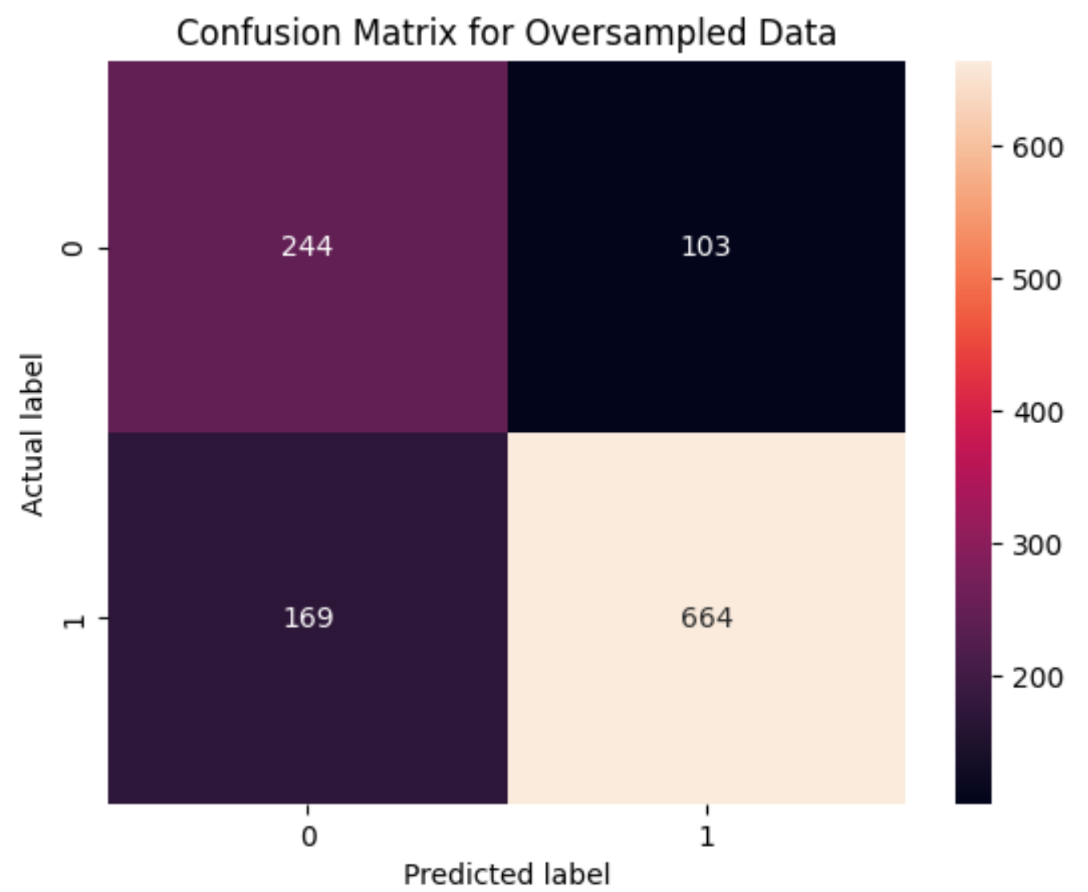
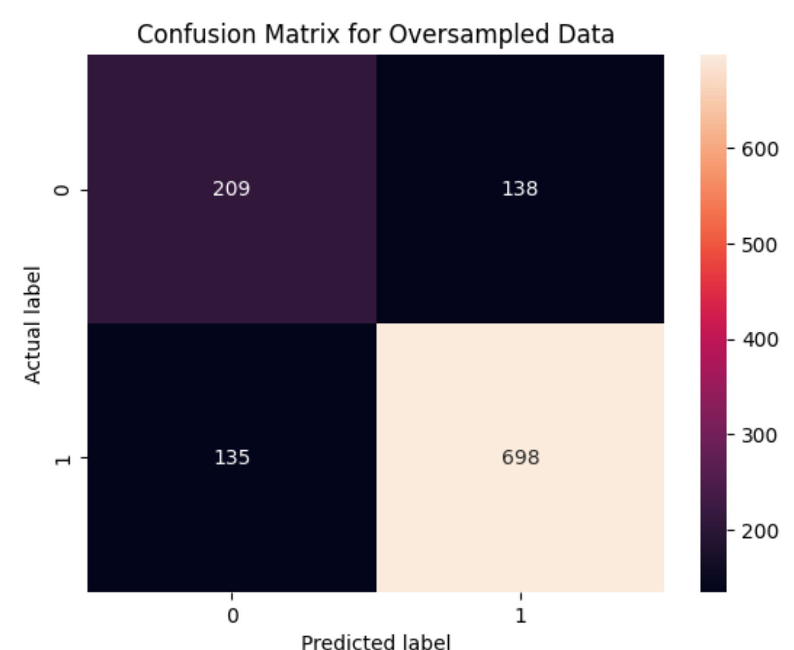
Decision Tree, Logistic Regression, K-nearest neighbors
Decision Tree | Logistic Regression | KNN

Slide 30
Conclusion
Random Forest produced the best accuracy overall compared to other models
The features that seemed to be prevalent in determining whether someone has CAD or not are:
Hypertension
Age
BNP level

Slide 31
Future Work
Try more fine-tuning
Consider removal of outliers
Expand training with more datasets
Try to incorporate other features than what we currently have

Slide 32
References/Links
[1]https://my.clevelandclinic.org/health/diseases/16898-coronary-artery-disease
[2]https://www.ncbi.nlm.nih.gov/pmc/articles/PMC5686931/#:~:text=other%20epidemiological%20studies.-,The%20major%20risk%20factors,activity%3B%20unhealthy%20diet%20and%20stress
[3]https://link.springer.com/article/10.1007/s42979-021-00731-4#Abs1
[4]https://www.sciencedirect.com/science/article/pii/S0169260718314585?via=ihub
fsoa-07-698.pdf (nih.gov)
Development and Validation of a Predictive Model for Coronary Artery Disease Using Machine Learning (nih.gov)
[5]https://www.kaggle.com/datasets/ashishsahani/hospital-admissions-data

Slide 33
Key Factors to Consider
Data-Related Factors:
Data Quality and Integrity
Relevant Features
Data Privacy and Ethics
Model-Related Factors:
Choice of Machine Learning Algorithm
Model Training and Validation
Interpretability and Explainability
Project Scope and Limitations:
Scope of the Prediction
Limitations and Challenges
Future Work and Improvements

Slide 34
Related Work
Paper2:
Coronary artery disease (CAD), the leading cause of global morbidity and mortality, is primarily driven by atherosclerosis, a complex process involving chronic inflammation, endothelial dysfunction, and vascular changes leading to narrowed arteries and reduced heart blood supply. Traditional diagnosis relies on invasive coronary angiography, which, despite its effectiveness, is limited in widespread screening due to its specialized requirements and radiation risks. This underscores the need for non-invasive, accurate CAD risk assessment tools….
Paper1:
Coronary artery disease (CAD) is correlated with many preventable risk factors. Early diagnosis of CAD allows for prevention of worsening of CAD and its complications. This study aims to utilize machine learning (ML) algorithms to predict for CAD in patients. Our results indicate that ML algorithms can accurately predict for CAD…
Paper4: n their study, Abdar et al. developed a novel data mining method to enhance coronary artery disease (CAD) prediction accuracy. They used the Z-Alizadeh Sani dataset, involving 216 CAD and 86 non-CAD patients. Key techniques included genetic algorithms, particle swarm optimization, and the N2Genetic optimizer for feature selection and optimization…
Paper3:
Muhammad et al.'s study [2] explored various machine-learning techniques to predict coronary artery disease in Nigerians, utilizing a dataset from two General Hospitals in Kano State. This dataset included both controllable (e.g., blood pressure) and uncontrollable (e.g., age) features, with 506 patients remaining after discarding rows with missing values…

